Slide 1

North South University CSE 299
Group Members:
1. Farzia Chowdhury-(1522115642)
2. MD.Seragis Salekin – (1632228042)
3. Md.Fuadul Islam-(1631355042)
Date of Submission: 20.06.2019
Section: 12
Group: 08
Submitted To: Intisar Tahmid Naheen(ITN)

Slide 2
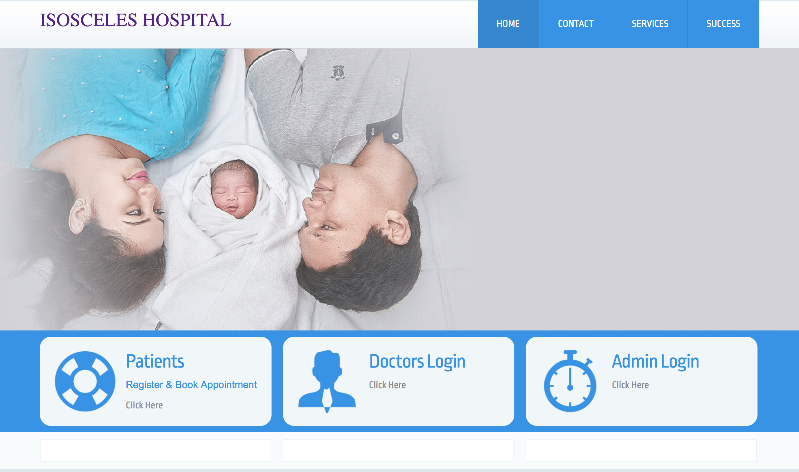

Slide 3
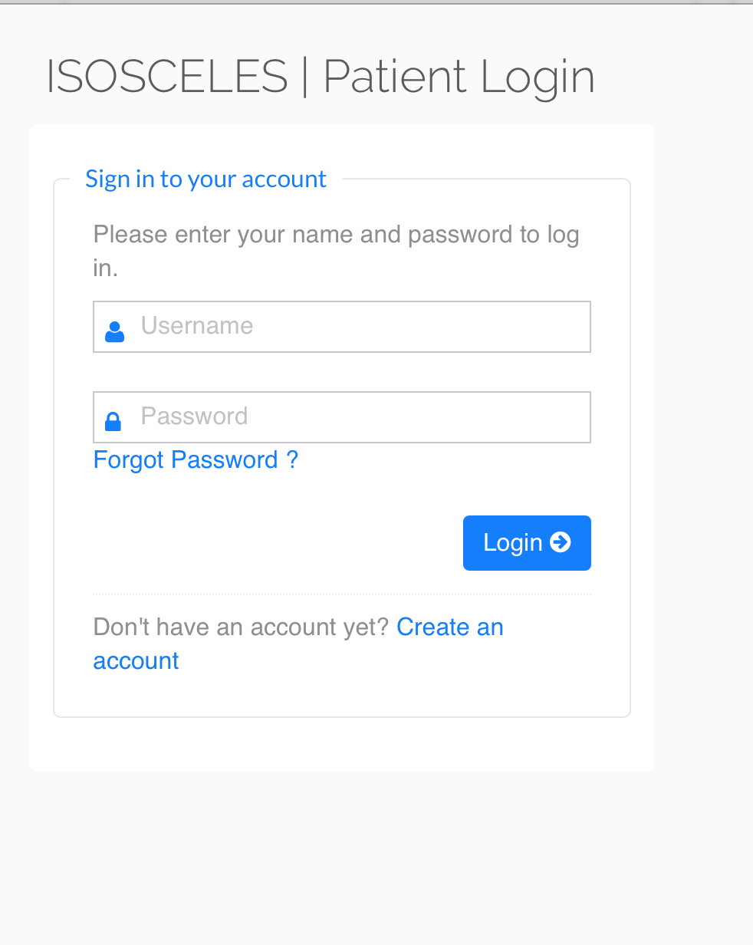

Slide 4
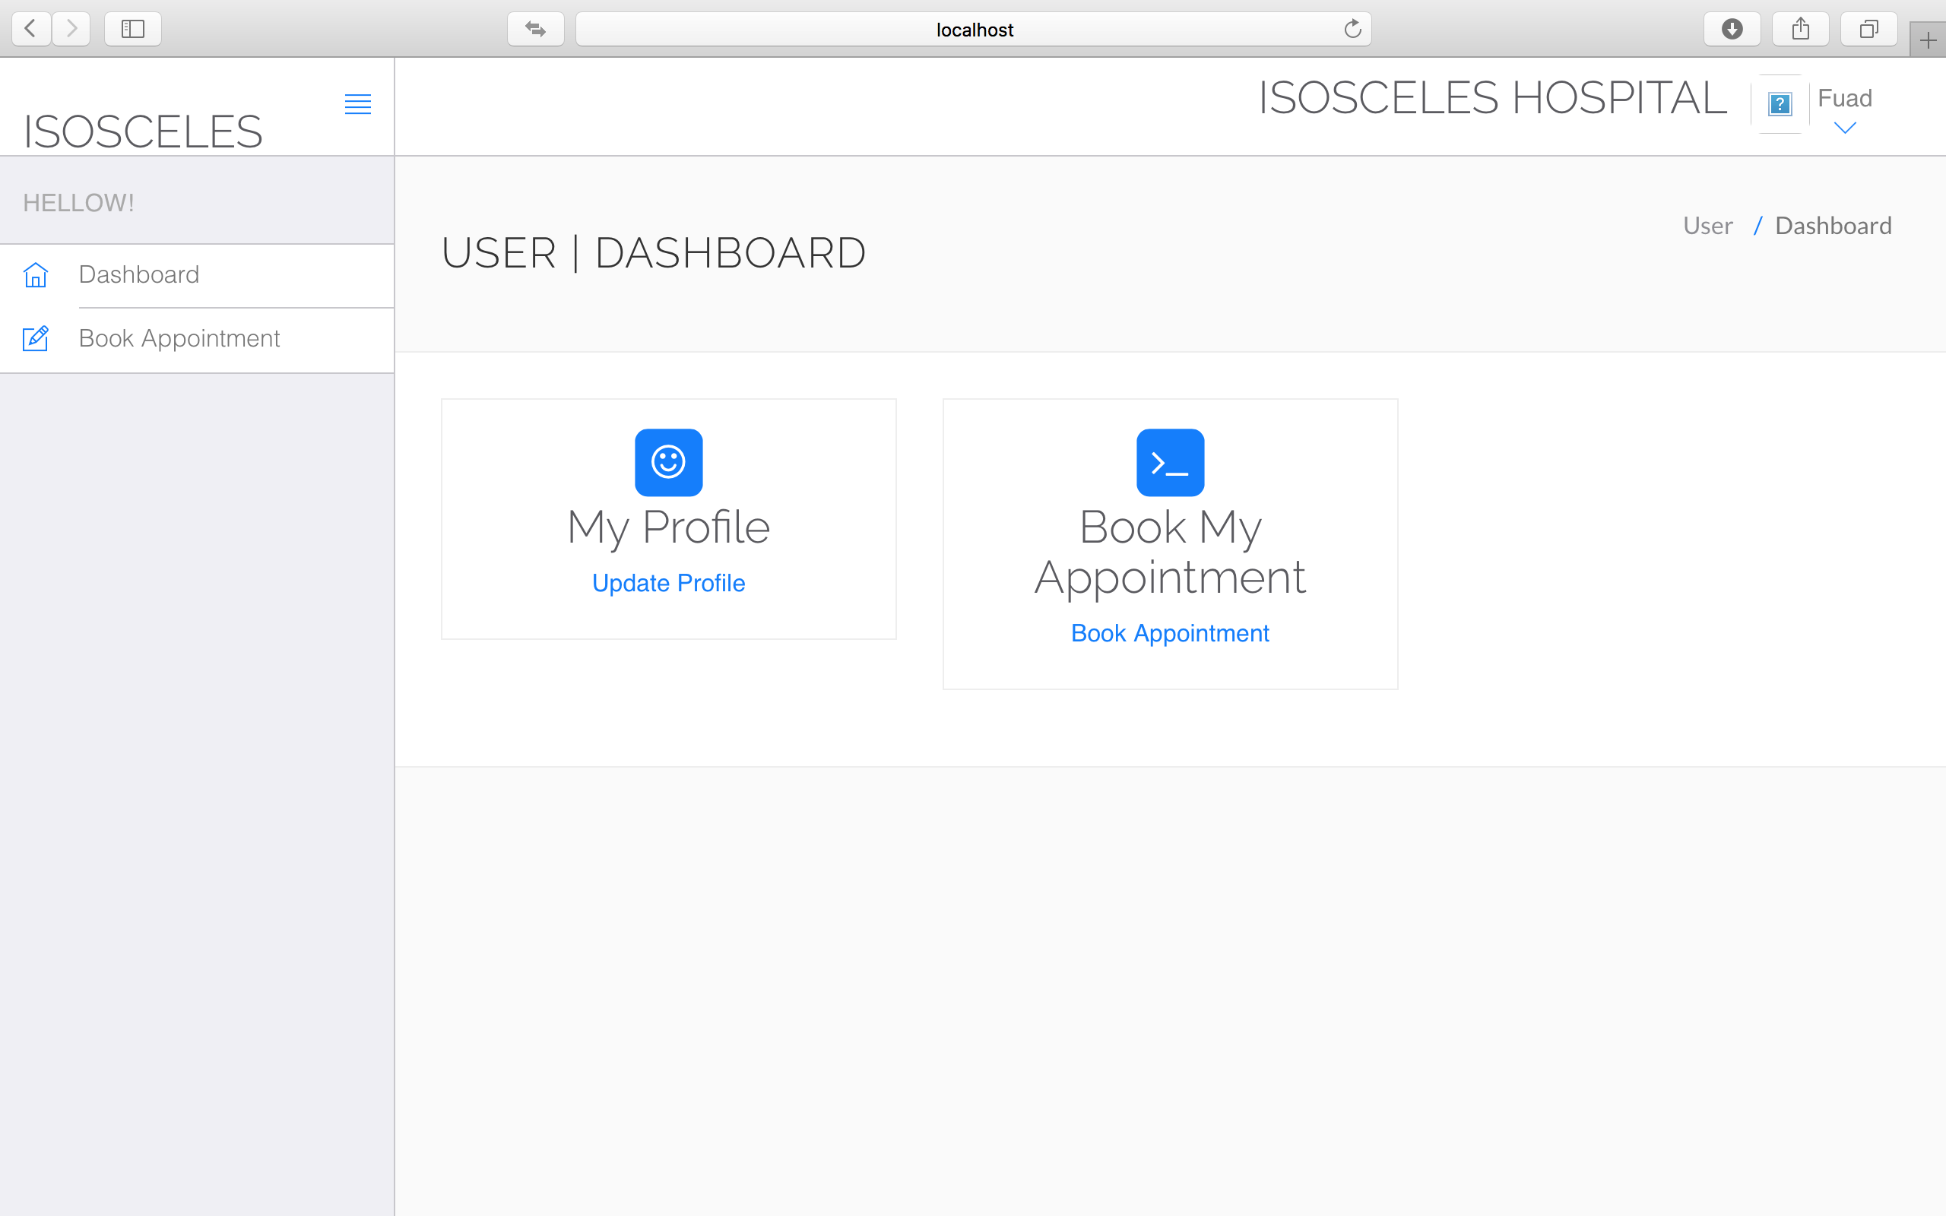

Slide 5
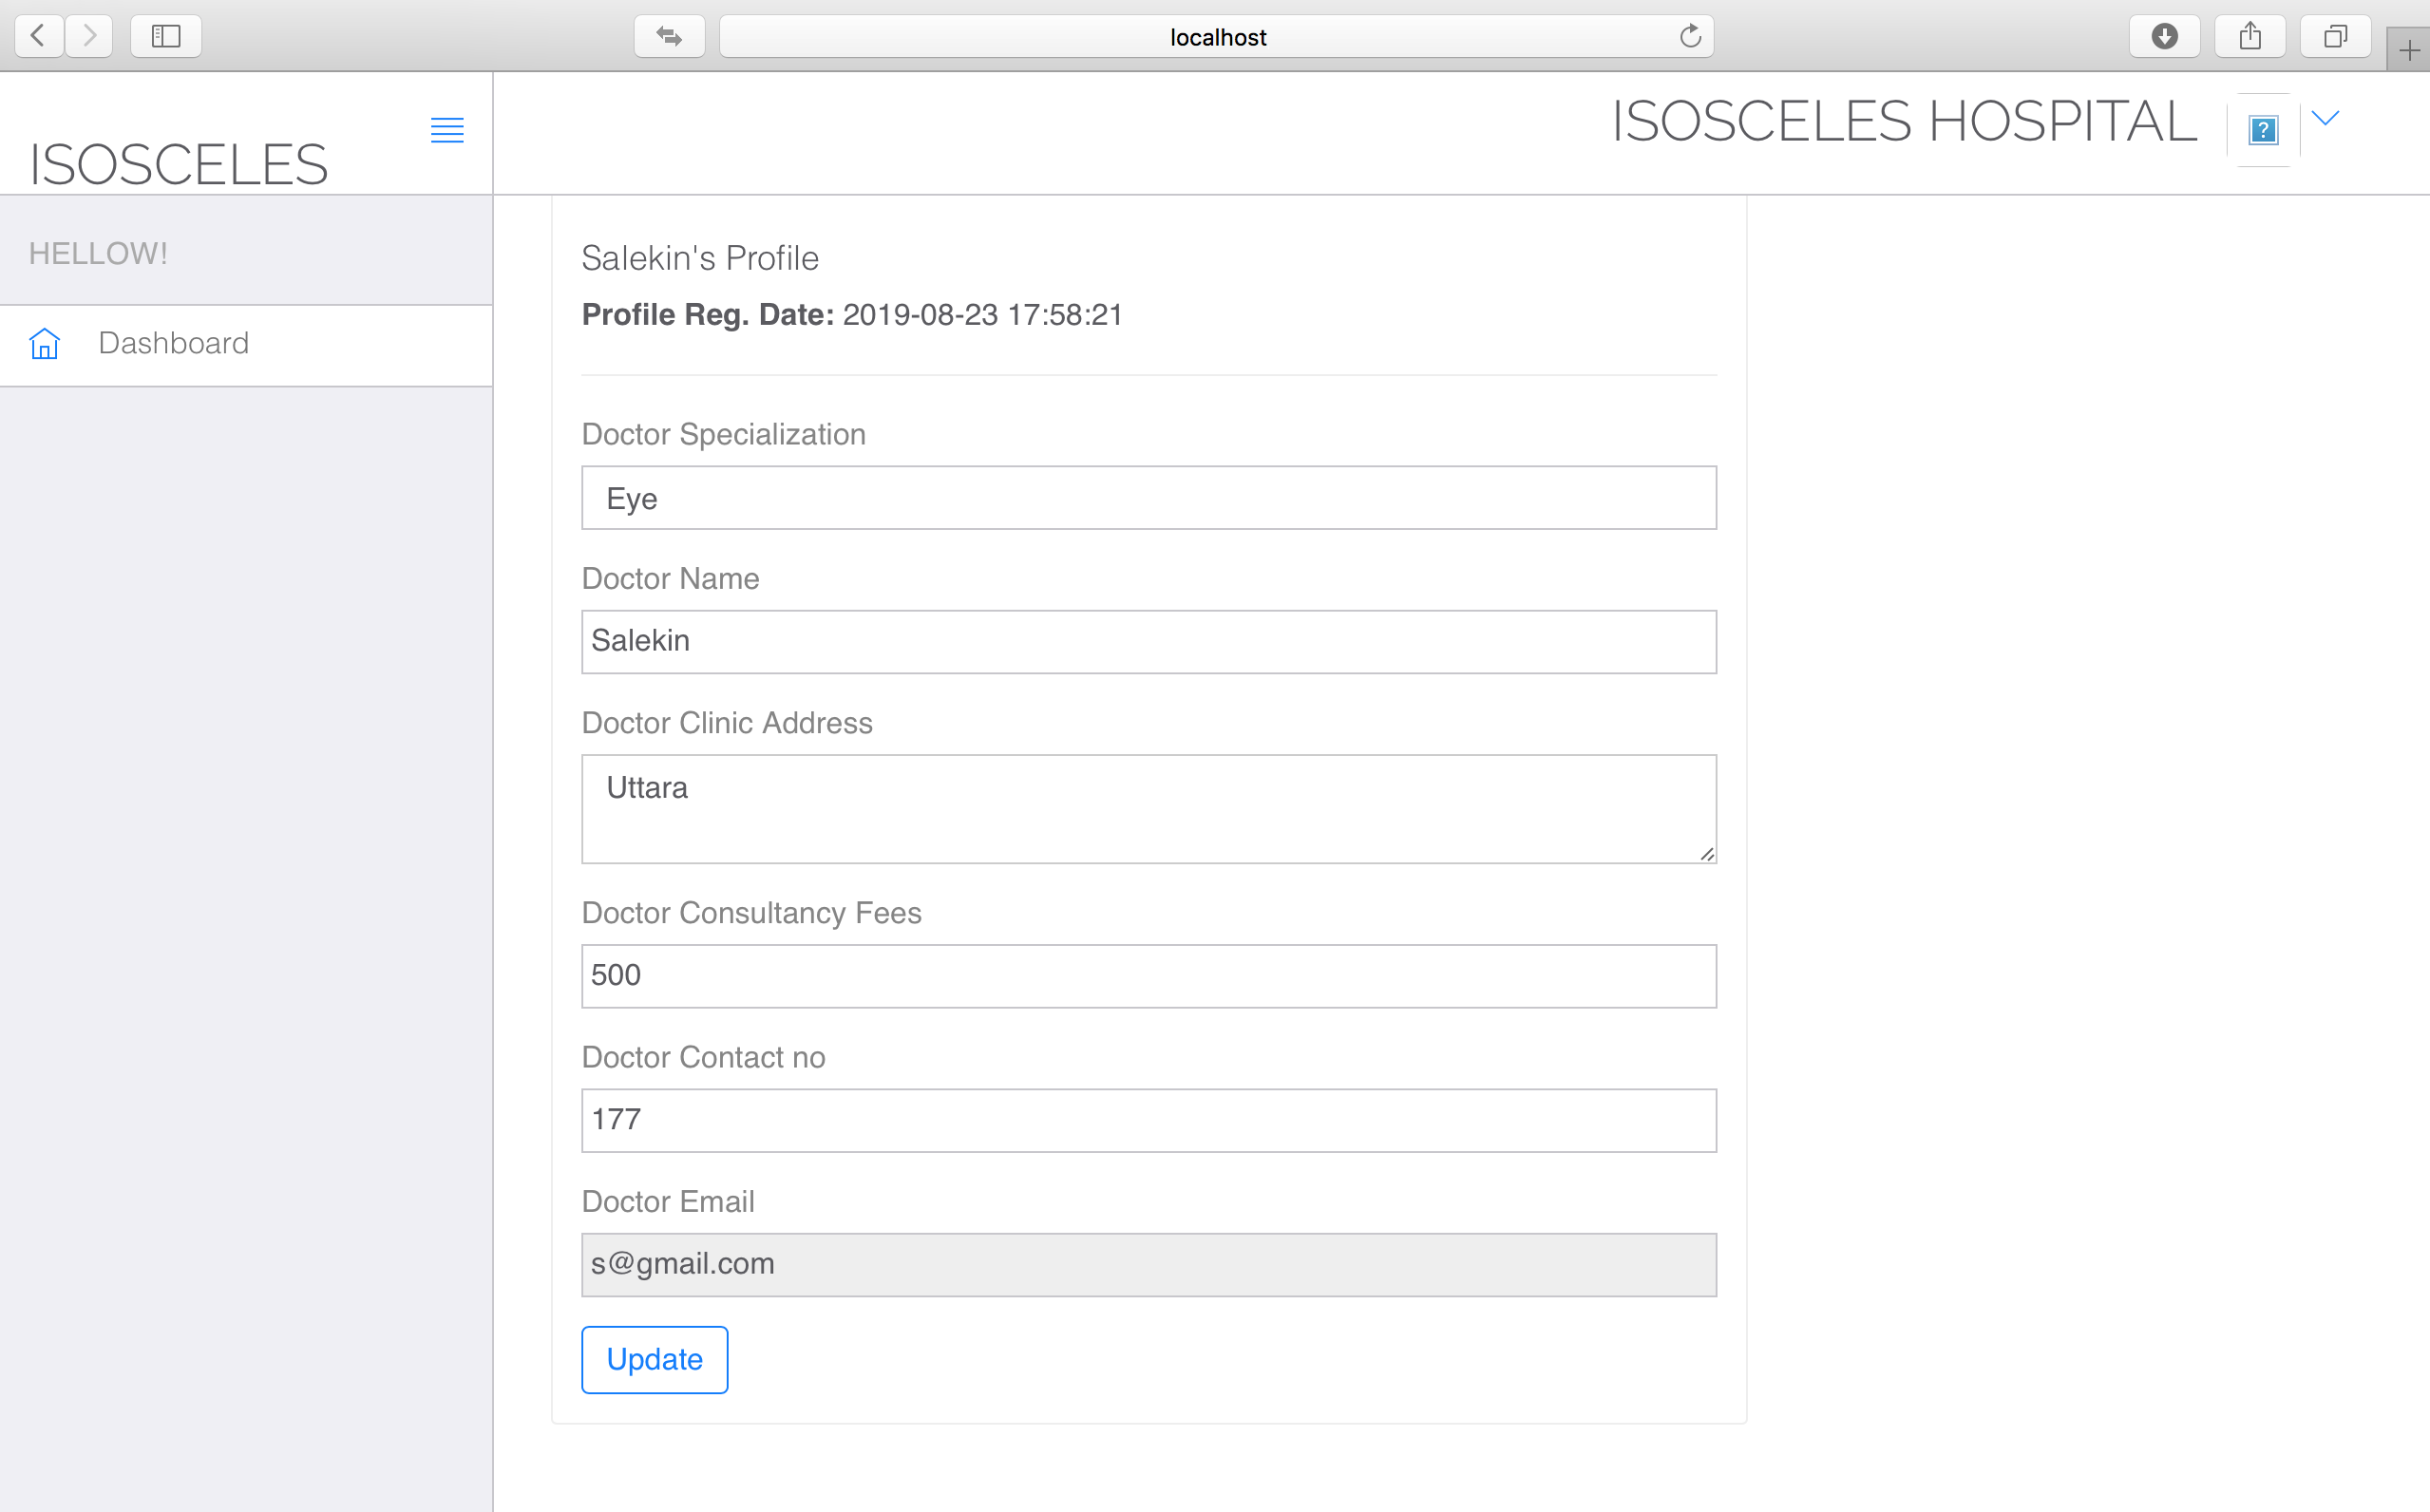

Slide 6
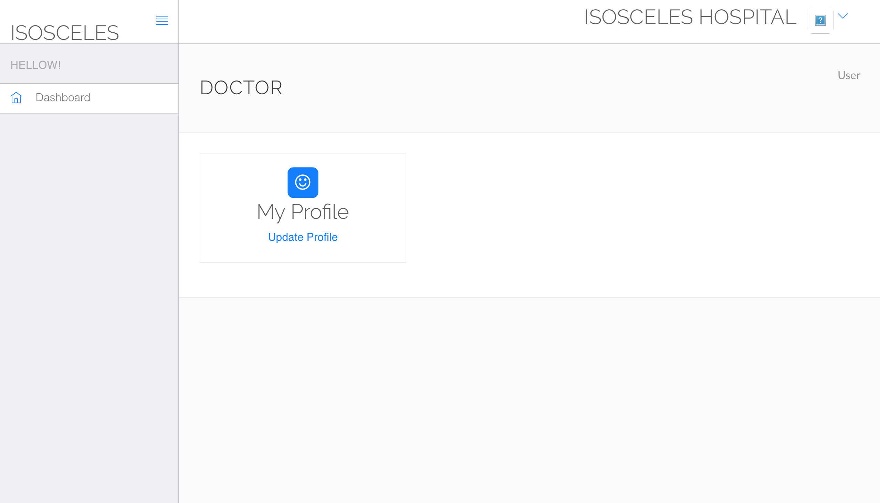

Slide 7
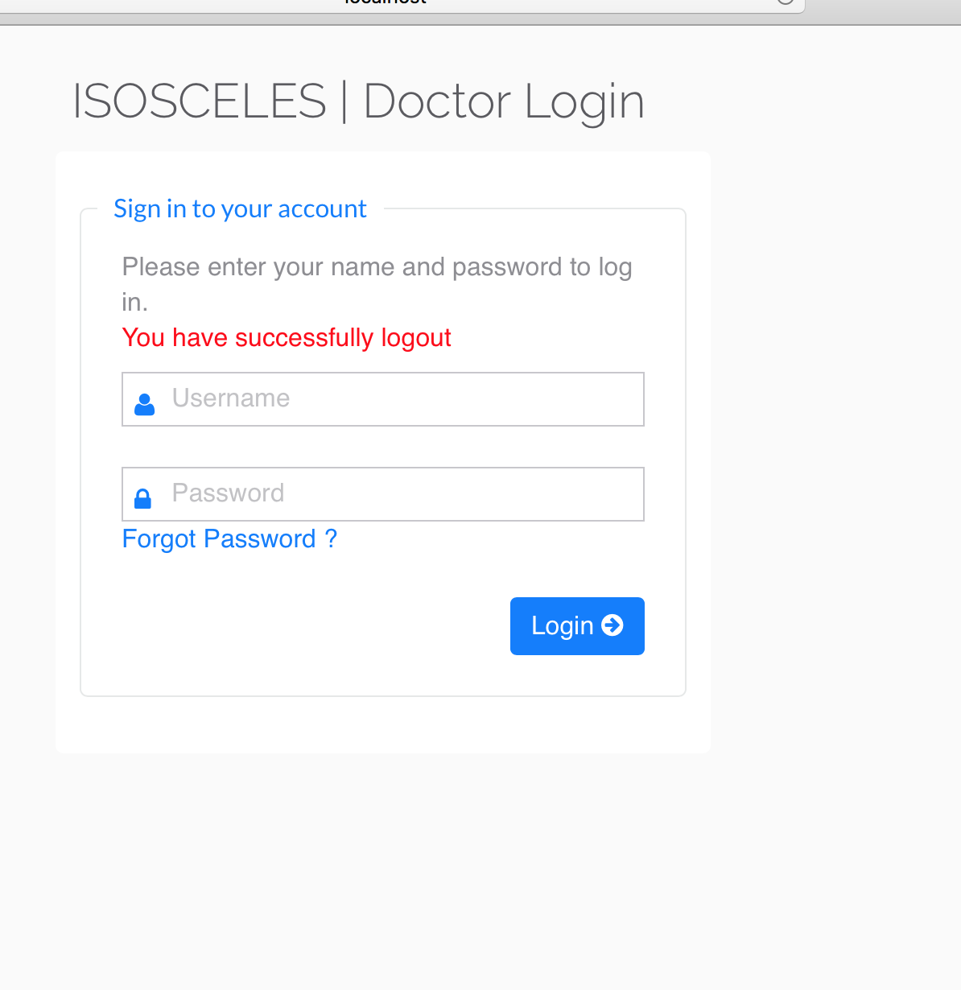

Slide 8
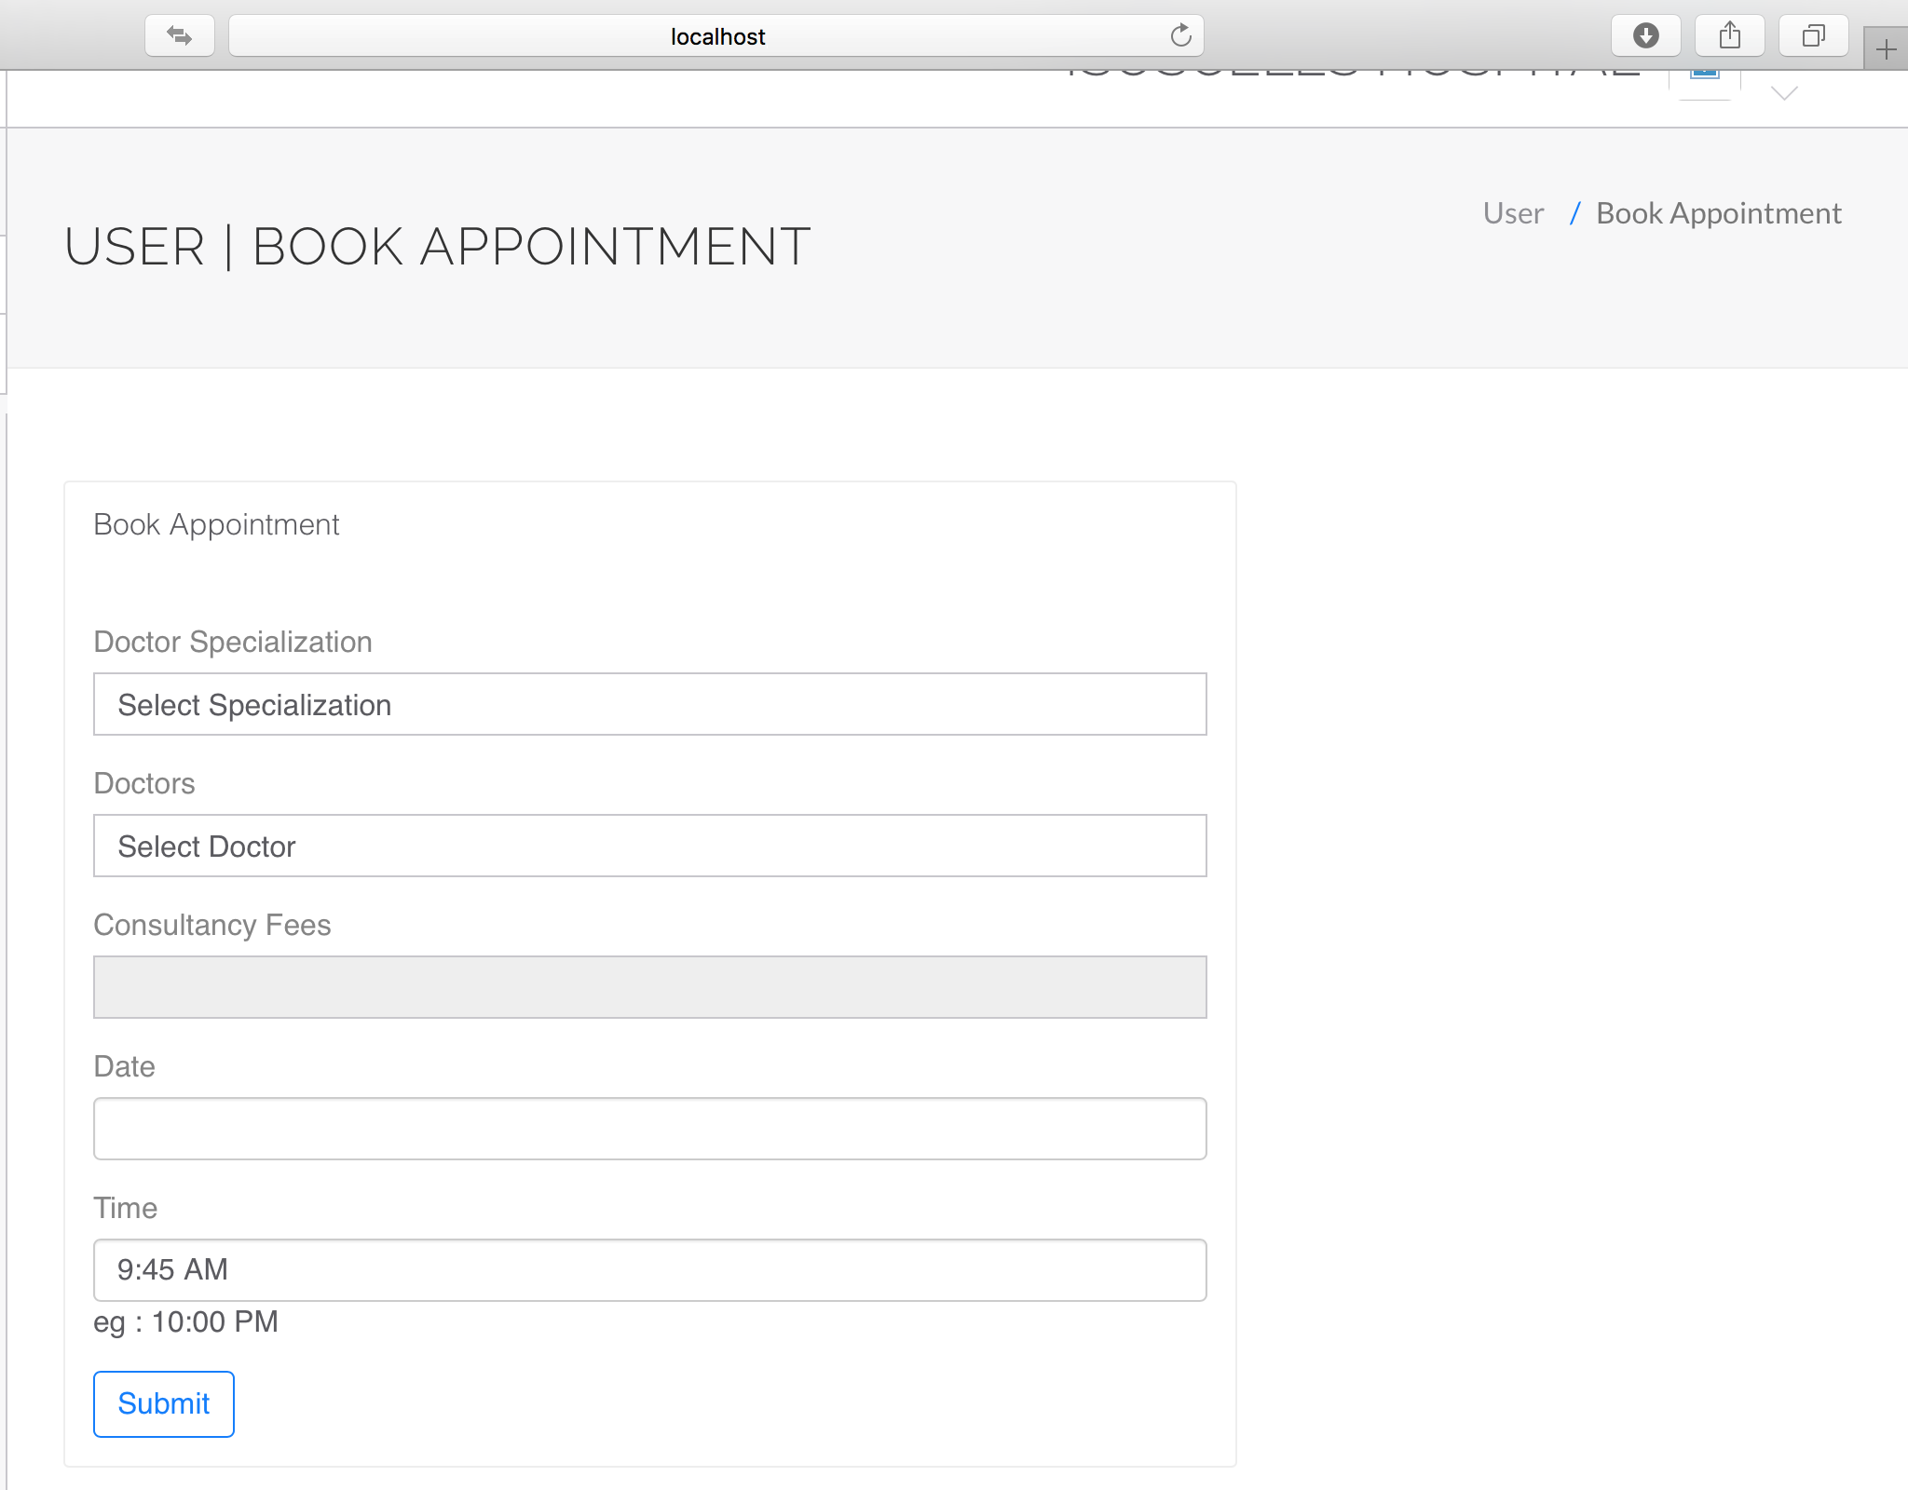

Slide 10
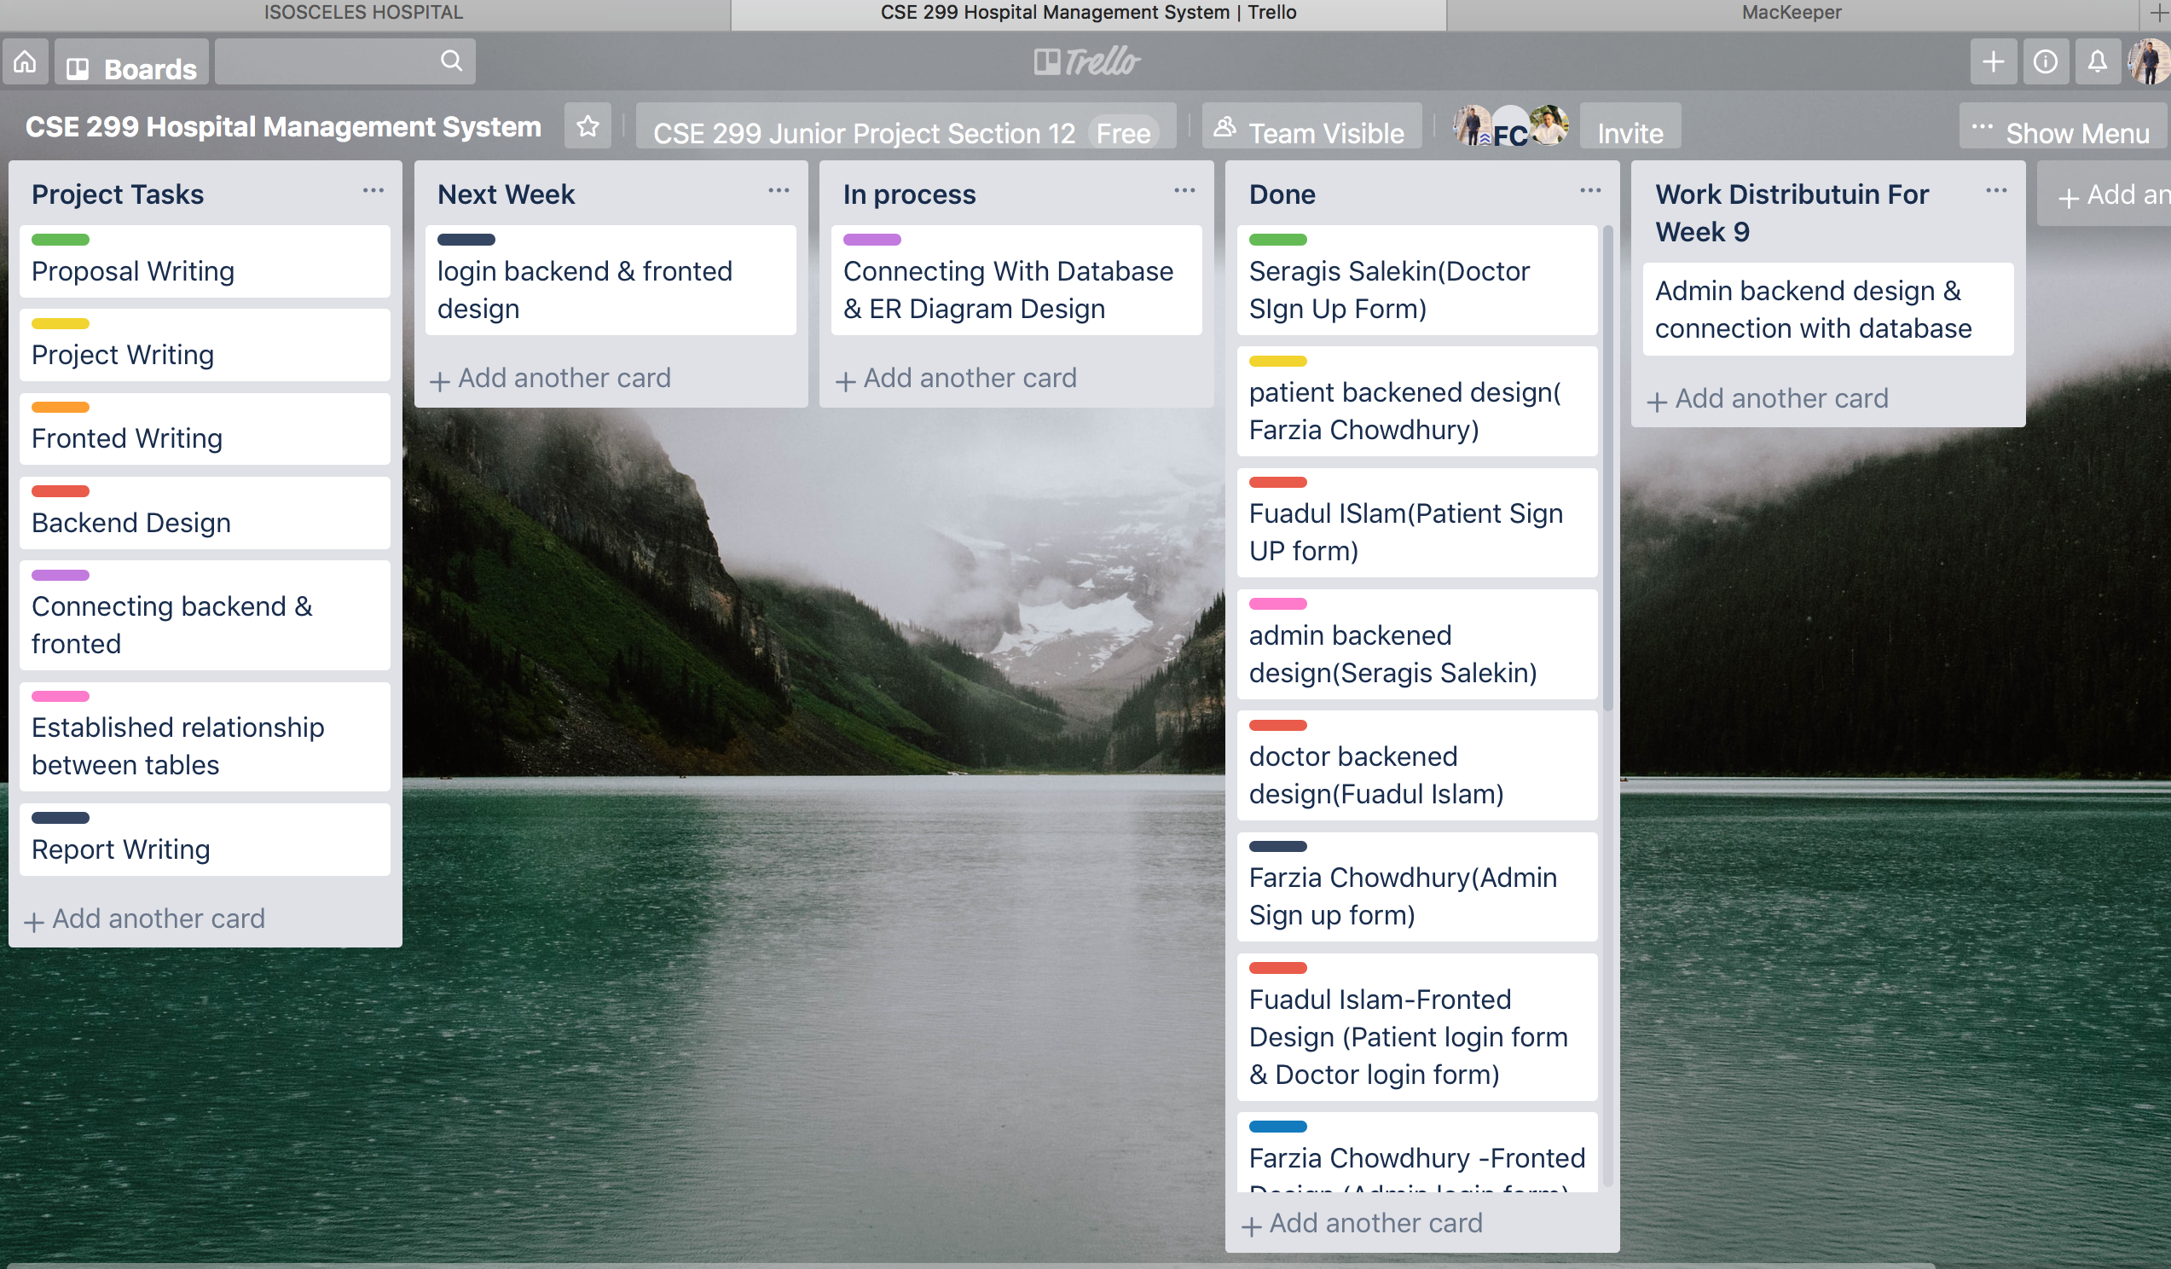

Slide 11
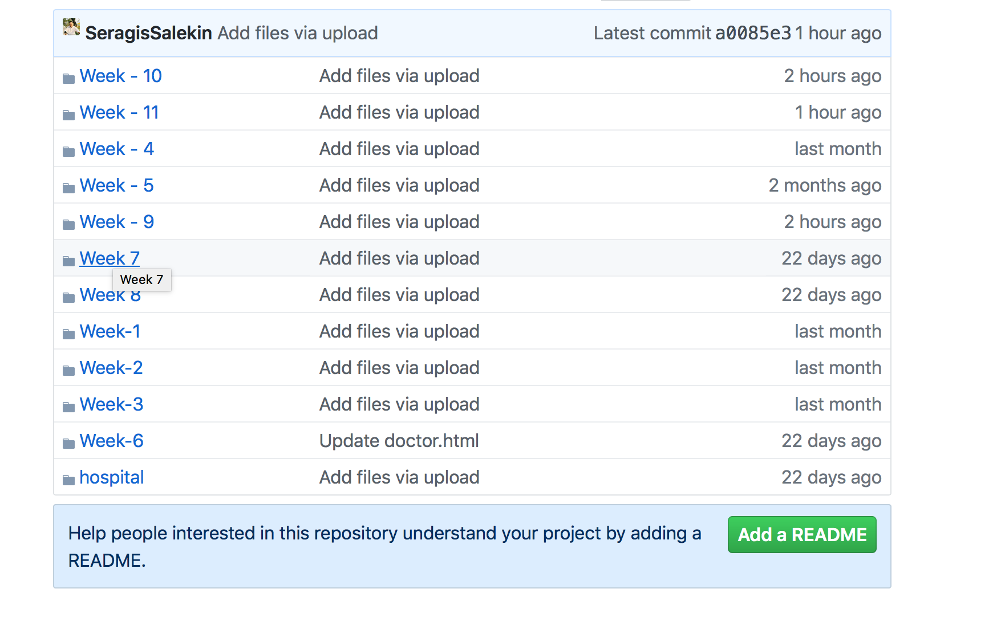

Slide 12
